Slide 1
A Style-Based Generator Architecture for Generative Adversarial Networks
CVPR 2019
Tero Karras, Samuli Laine, Timo Aila
Presented by Beomsoon Park
C&I LAB

Slide 2
Contents
Introduction
Style-based Generator
Properties of the style-based generator
Disentanglement Studies
Results
C&I LAB

Slide 3
Introduction
C&I LAB

Slide 4
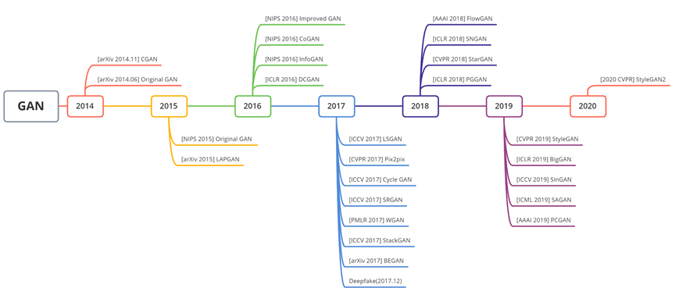
Introduction
History of GAN
+ Normalization Techniques
+ Optimization Techniques
+ Auxiliary Structural Transformation
https://roytravel.tistory.com/109
C&I LAB

Slide 5
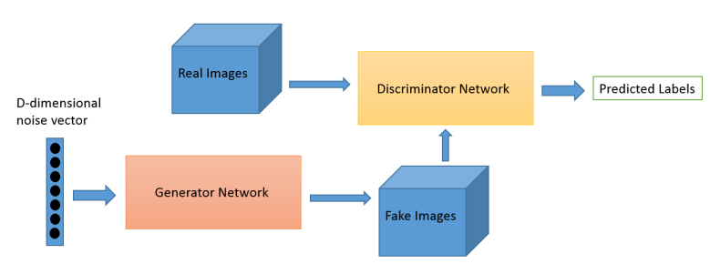
Introduction
History of GAN
Original GAN
C&I LAB

Slide 6
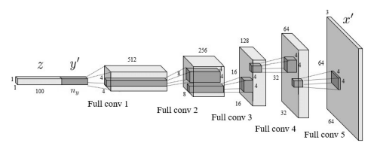
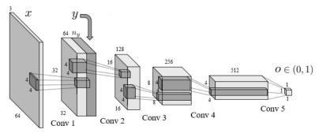
Introduction
History of GAN
cGAN
C&I LAB

Slide 7
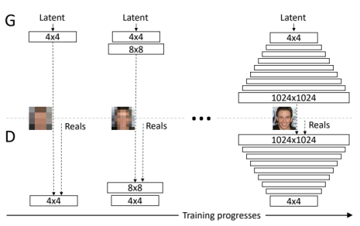
Introduction
History of GAN
ProGAN
C&I LAB

Slide 8
Introduction
Problem of previous models
Original GAN
cGAN
ProGAN
Image Generation based on single latent space
C&I LAB

Slide 9
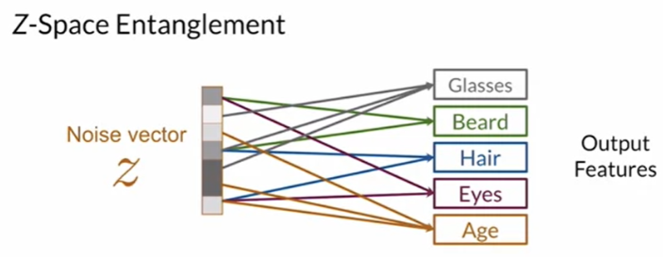
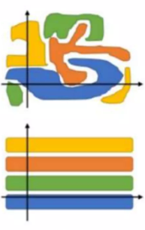
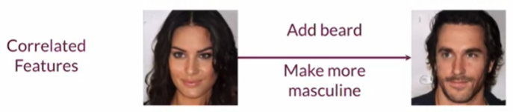
Introduction
Entanglement in latent space
Actual Distribution
Unexpected Impacts on other features
Desired
(Completely Distinguished)
Less control over
the latent space & the generator
Motivation for style-based generator
https://velog.io/@tobigs-gm1/Disentanglement
C&I LAB

Slide 10
Style-based Generator
C&I LAB

Slide 11
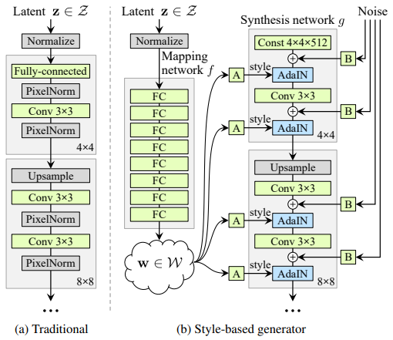
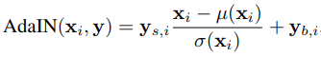
Style-based Generator
Model Structure
Mapping Network $f :𝒵→𝒲$ (8-layer MLP)
$w∈𝒲$ : Intermediate Latent Vector
Learnable Affine Parameters
“Style”
“Adaptive Instance Normalization”
C&I LAB

Slide 12
Style-based Generator
Model Structure
“Adaptive Instance Normalization”
Normalization on each feature map
Scaling & Biasing with “Style”
Adding “Style” to the image that is being generated
C&I LAB

Slide 13
Style-based Generator
Model Structure
Uncorrelated Gaussian Noise
per-feature scaling factors
(Learnable)
Broadcast
Feature Maps
Modified Feature Maps
Convoluted Feature Maps
C&I LAB

Slide 14
Style-based Generator
Model Structure
Uncorrelated Gaussian Noise
per-feature scaling factors
(Learnable)
Uncorrelated Gaussian Noise
Broadcast
Feature Maps
Generate “Stochastic Detail”
Modified Feature Maps
Convoluted Feature Maps
C&I LAB

Slide 15
Properties of the Style-based Generator
C&I LAB

Slide 16
Properties of the Style-based Generator
Distinct Properties
Localized effects of styles
Stochastic Variation
Style Mixing
C&I LAB

Slide 17
Properties of the Style-based Generator
Localization of the effects of styles
Achieve Localization
Normalization of each feature vector
Force the convolution to be performed
only based on the preceding features
Scaling & Biasing based on the style
Control the convolution in the desired direction as indicated in the style
C&I LAB

Slide 18
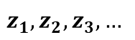

Properties of the Style-based Generator
Mixing Regularization
Generated Images
$$z_{1}, z_{2},z_{3}, …$$
$$z_{1}$$
C&I LAB

Slide 19
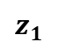
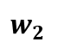
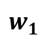

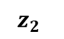
Properties of the Style-based Generator
Style Mixing
Latent Codes
4 X 4
$$z_{1}$$
$$z_{2}$$
8 X 8
$$w_{1}$$
16 X 16
Mapping
Network
$$f$$
256 X 256
$$w_{2}$$
1024 X 1024
C&I LAB

Slide 20
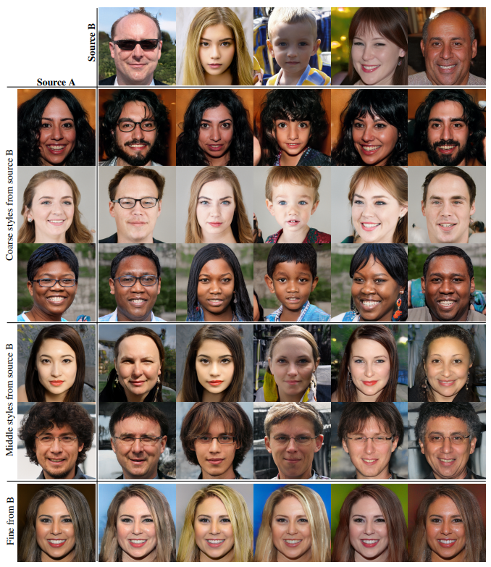
Properties of the Style-based Generator
Style Mixing
“Coarse Styles” from source B
“Fine Styles” from source A
“Middle Styles” from source B
“Middle Styles” from source A
“Fine Styles” from source B
“Coarse Stylse” from source A
C&I LAB

Slide 21
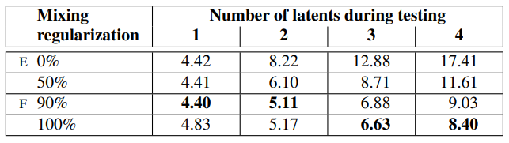
Properties of the Style-based Generator
Style Mixing
FID scores in FFHQ
* FFHQ : New dataset of human faces created with style-based generator
C&I LAB

Slide 22
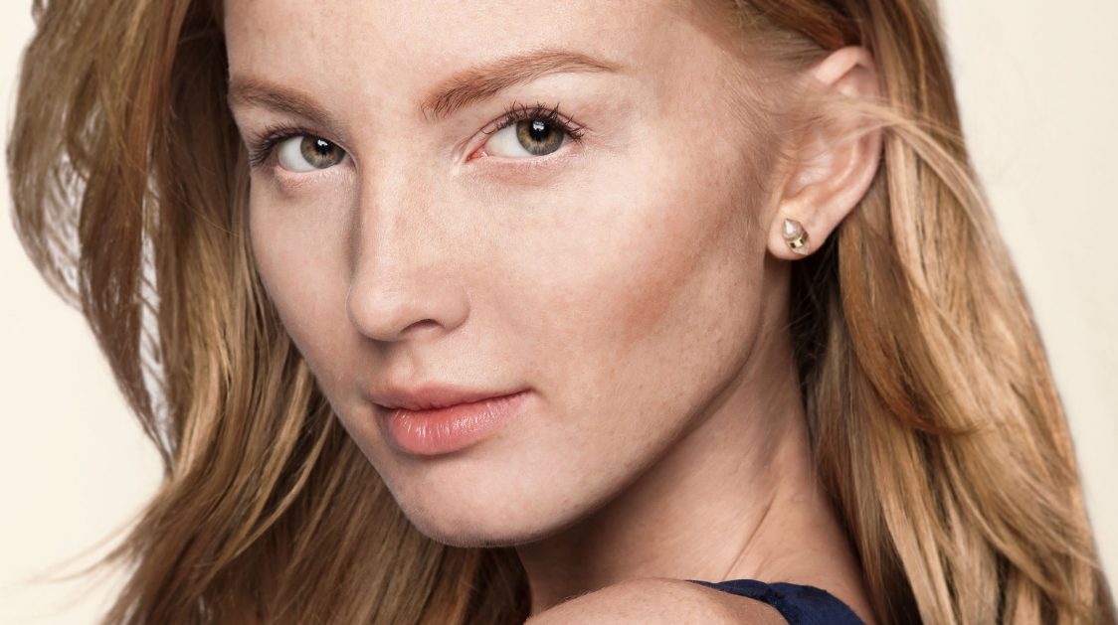
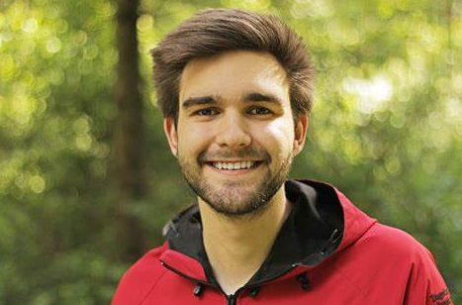
Properties of the Style-based Generator
Stochastic Variation
Stochastic aspects in the picture of humans
Can be randomized
without affecting the perception
C&I LAB

Slide 23
Properties of the Style-based Generator
Stochastic Variation
Difficult to achieve with traditional generators
Latent information can be supplied only through the input layer
Hard to specify when and how many spatially-varying pseudorandom numbers should be generated
Require more network capacity
Inevitable exposure of the periodicity of generated signal
C&I LAB

Slide 24
Properties of the Style-based Generator
Stochastic Variation
Add per-pixel noise after every convolution
With the help of per-feature scaling factors
Fresh noise is supplied to every layer (Features)
Only affects stochastic aspects (= Effect is localized)
C&I LAB

Slide 25
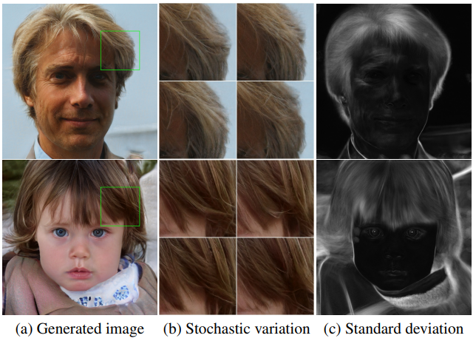
Properties of the Style-based Generator
Stochastic Variation
White parts
→ High Variations
Black parts
→ Low Variations
C&I LAB

Slide 26
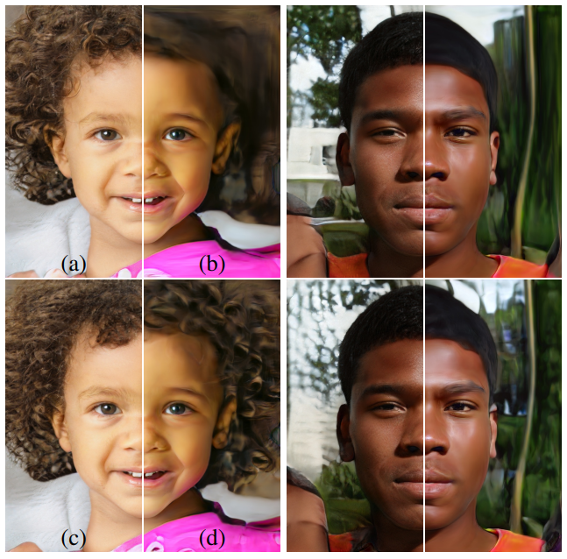
Properties of the Style-based Generator
Stochastic Variation
(a) : All layers
(b) : No noise
(c) : Fine Layers
(d) : Coarse Layers
Different Results according to the stage that noise is injected
C&I LAB

Slide 27
Properties of the Style-based Generator
Style & Stochasticity
Style
Affect the entire image → Features are controlled coherently with
Stochasticity
- Noise added to all pixels independently → Only handle stochastic variation
Unsupervised learning with appropriate use of global and local channels
C&I LAB

Slide 28
Disentanglement Studies
C&I LAB

Slide 29
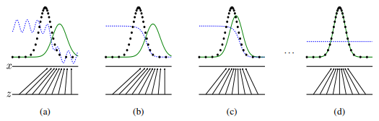
Disentanglement Studies
Entanglement in $𝓩$
Sampling probability is forced to follow the density function of training data
I. Goodfellow et al. Generative Adversarial Networks. In NIPS, 2014.
C&I LAB

Slide 30
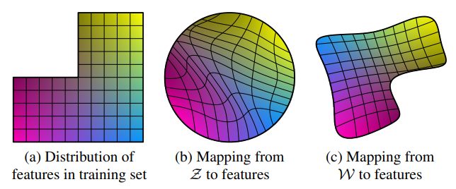
Disentanglement Studies
Achieve Disentanglement with $𝓦$
Non-existing Combination
Long Hair
&
High manly
Hair
Length
Masculinity
2 factors of variation (Masculinity & Hair Length)
C&I LAB

Slide 31
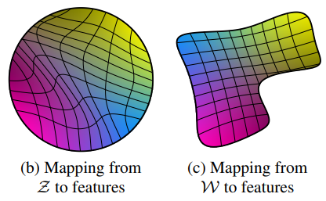
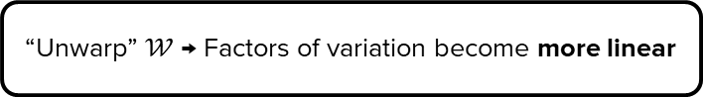
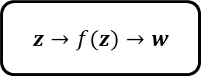
Disentanglement Studies
Achieve Disentanglement with $𝓦$
Non-linear
Linear
“Unwarp” $𝒲$ → Factors of variation become more linear
Mapping function → Help disentanglement through training
$z→f(z)→w$
C&I LAB

Slide 32
Disentanglement Studies
New metrics for quantifying disentanglment
Previous suggested metrics : Not suitable
No encoder to yield latent codes
Perceptual Path Length
Linear Separability
C&I LAB

Slide 33
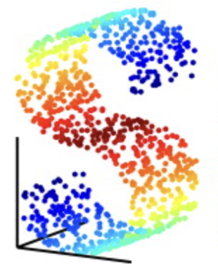
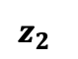
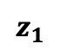
Disentanglement Studies
Perceptual Path Length
How to quantify disentanglement?
Interpolation path in latent space
$$z_{2}$$
Non-existing new feature in the latent space
Entangled Latent Space
$$z_{1}$$
https://www.jkobject.com/blog/umap-explanation/
C&I LAB

Slide 34
Disentanglement Studies
Perceptual Path Length
How to quantify disentanglement?
Interpolation path in latent space
Proposed Metric
The amount of change while performing interpolation in the latent space
C&I LAB

Slide 35
Disentanglement Studies
Perceptual Path Length
Perceptually-based pairwise image distance
Weighted Difference between 2 VGG16 embeddings
Human-like Similarity Judgement on images
< Interpretation to the perceptual path length >
Low
High
High Similarity → Smooth Change
Low Similarity → Drastic Change
“More disentangled”
“Less disentangled”
C&I LAB

Slide 36
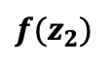
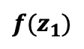
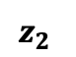
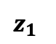
Disentanglement Studies
Perceptual Path Length
$$z_{2}$$
$${f(z}_{2})$$
Interpolation path
→ Subdivided into linear segments
$$z_{1}$$
$${f(z}_{1})$$
Total perceptual length
= The sum of perceptual differences over each segment
C&I LAB

Slide 37
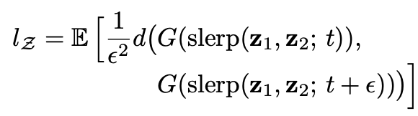
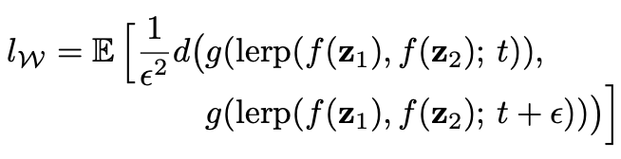
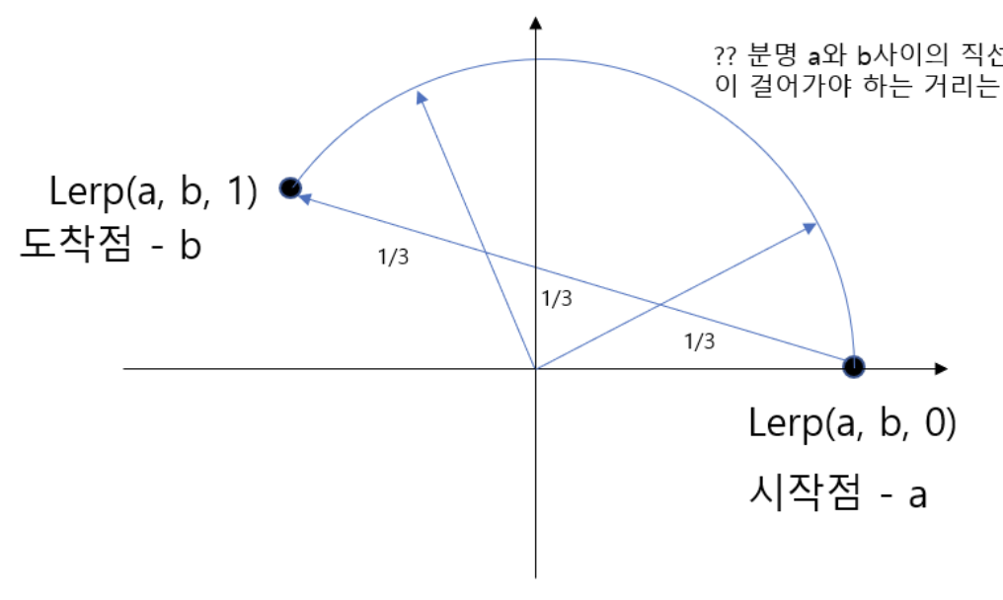
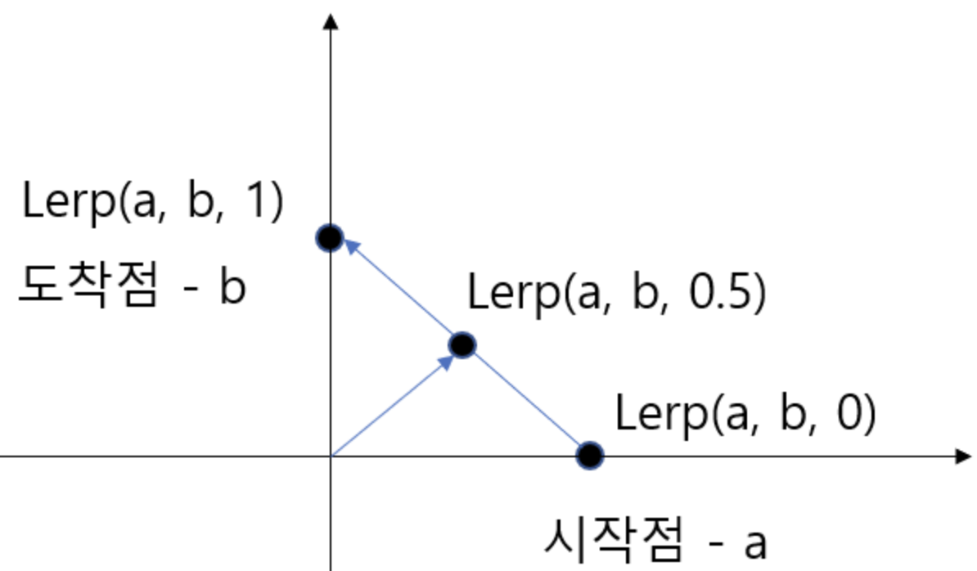


Disentanglement Studies
Perceptual Path Length
Perceptual Path Length in $𝓩$
Perceptual Path Length in $𝓦$
Slerp(a, b, 2/3)
* slerp : Spherical Interpolation
* lerp : Linear Interpolation
Slerp(a, b, 1/3)
https://gnaseel.tistory.com/14
C&I LAB

Slide 38
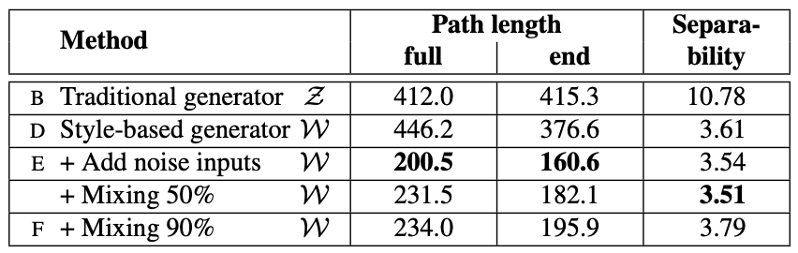
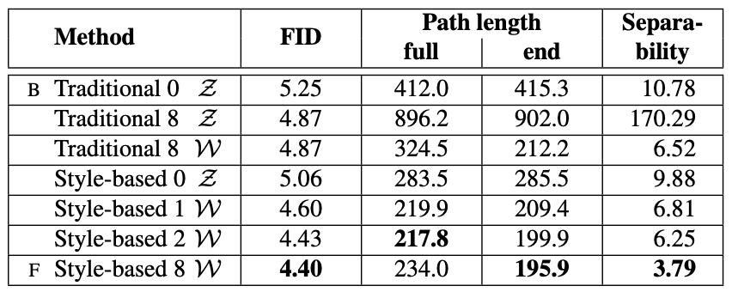
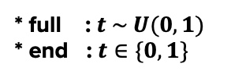
Disentanglement Studies
Perceptual Path Length
Perceptual Path Length and Separability score
depending on the architecture
Results depending on
the architecture and depth of mapping network
* full : $t \sim U(0,1)$
* end : $t∈\{0,1\}$
C&I LAB

Slide 39
Disentanglement Studies
Linear Separability
If sufficiently disentangled..
Direction vectors consistently pointing to the corresponding factors of variation should exist
Proposed Metric
How well latent-space points can be separated into distinct 2 sets
= How clearly each set can represent binary attribute
C&I LAB

Slide 40
Disentanglement Studies
Linear Separability
Train auxiliary classification networks
Obtain binary attributes
Same as the discriminator in ProGAN
Generate 200000 images to evaluate one of the attributes
Perform classification
Leave the most confident samples
(100000 samples)
C&I LAB

Slide 41
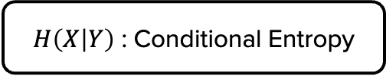
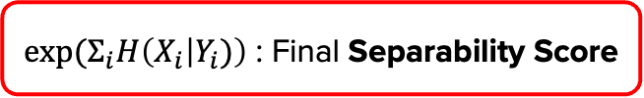
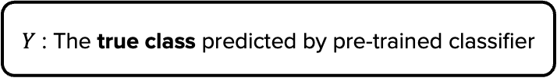
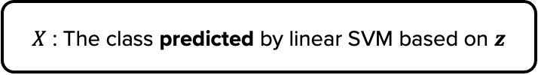
Disentanglement Studies
Linear Separability
$X$ : The class predicted by linear SVM based on $z$
$H\left(X | Y\right)$ : Conditional Entropy
$Y$ : The true class predicted by pre-trained classifier
The amount of additional information to determine the true class
$exp⁡(Σ_{i}H\left(X_{i} | Y_{i})\right)$ : Final Separability Score
C&I LAB

Slide 42
Disentanglement Studies
Linear Separability
Perceptual Path Length and Separability score
depending on the architecture
Results depending on
the architecture and depth of mapping network
C&I LAB

Slide 43
Results
C&I LAB

Slide 44
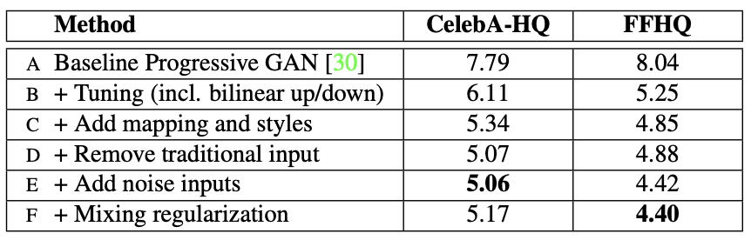
Results
Comparing with other generators
FID scores for various generators
C&I LAB

Slide 45
Results
Perceptual Path Length & Separability
Even the traditional model has performed better when $𝒲$ is introduced
Best results are derived from the proposed model → $𝓦$ is less entangled than $𝓩$
C&I LAB

Slide 46
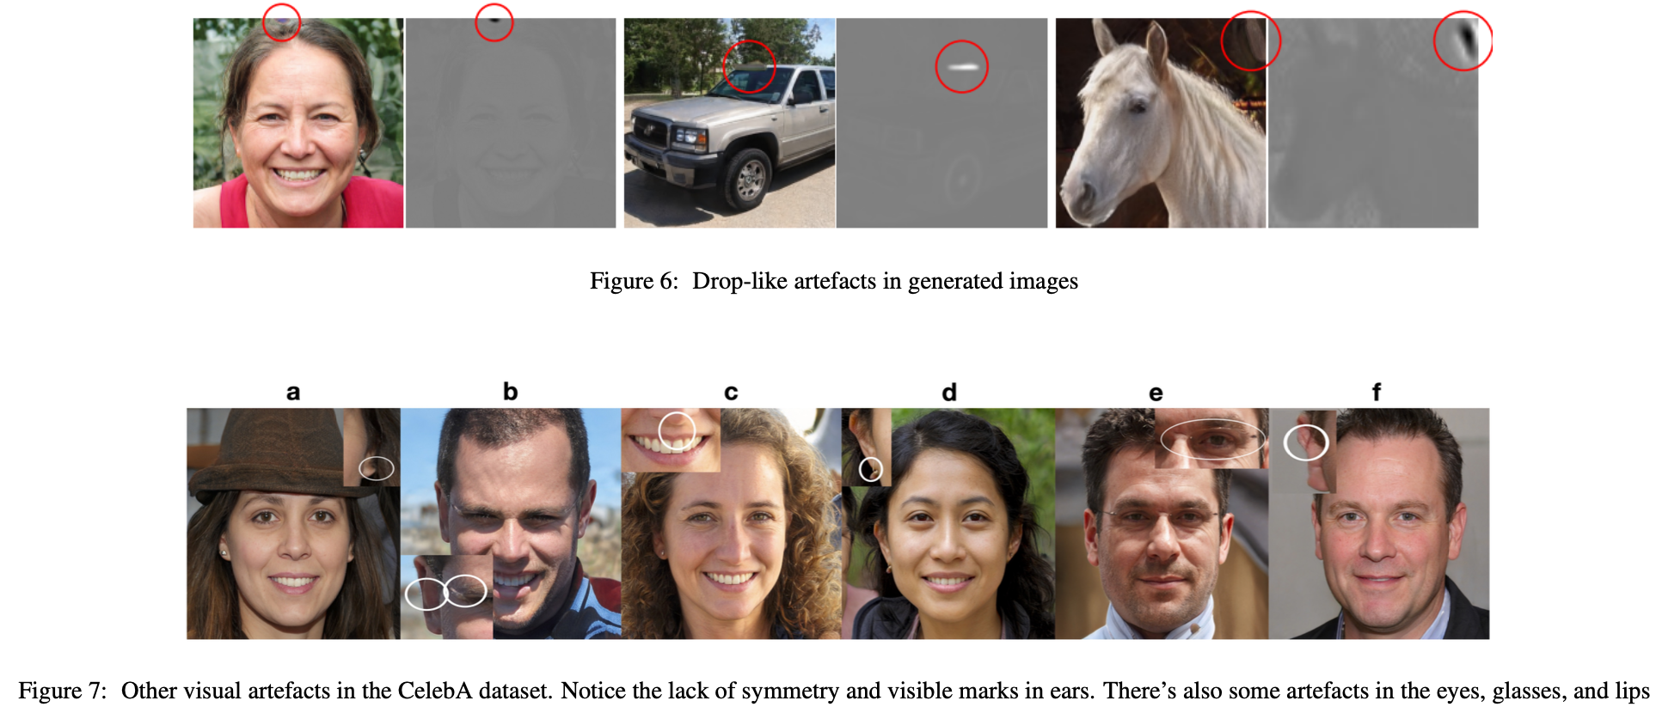
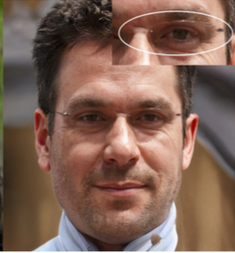
Results
Unresolved problem
C&I LAB

Slide 47
Thank you
C&I LAB

